Slide 1
From to
Fuzzy
Fluent
Semantic Code Search in Vim/Neovim
By OKABE Gota (@sirasagi62)
Notes:
So, Now I will start my lightning talk,
<<ENTER>>
From fuzzy to fluent: sementic code search in Vim and Neovim.

Slide 2



I’m Sirasagi62
Sendai, Japan
Tohoku Univ.
TS/Go/Python/C++ …
About 10 years
Notes:
I'm Sirasagi62. I'm an undergraduate livin’in Sendai, who have been using Vim and Neovim for about 10 years.

Slide 3

Finder
Notes:
Today I'd like to talk about "Finder".
As you know, Neovim and Vim already have a lot of fuzzy finders such as telescope, fern（ファーン）, fzf.vim and so on.
You're probably thinking something like this:

Slide 4


Notes:
“Are you talking about Yet Another Fuzzy Finder AGAIN!?“
But this time it's different, because

Slide 5
No, It’s Fluent.
Notes:
Today, I'd like to introduce a new type of finder, the "Fluent" Finder.

Slide 6
Motivation
Finding code is difficult
“Searching with different verb with same meaning”
“Can’t think of what words to search”
Notes:
Finding code in programming is incredibly difficult, isn’t it? You've probably experienced something like this when trying to search using keywords and grep:
"I kept searching using a different verb with the same meaning and couldn't find the function."
"I couldn't even think of what words to use to search in the first place.”

Slide 7
Motivation
Finding code is difficult
“Searching with different verb with same meaning”
“Can’t think of what words to search”
→ Cannot use synonym or sentences
Notes:
Fuzzy Finders search text based on fuzzy matching of words, so they cannot perform searches using synonym or sentences.
Unfortunately, even in this age where artificial intelligence can ”write” code, the task of “reading“ code will not disappear. Therefore, we need to address this problem both now and in the near future.

Slide 8

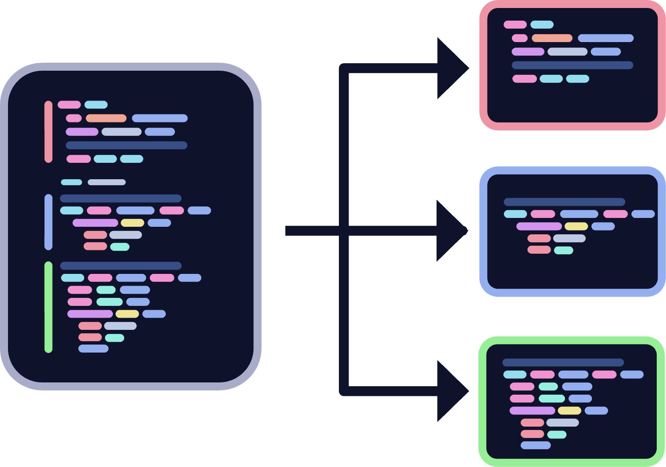




What is Fluent Finder and flf-vim
flf-vim
flf-vim finds code semantically
→ AI understands the meaning of the code
Notes:
Solving this problem is flf-vim, the world's first Fluent Finder.
Fluent Finder searches for text using vector search based on a language model, not simple string matching.
In other words, This means that the AI understands the meaning of the code and searches for it without being limited by the surface text.
It uses Tree-sitter for splitting code into chunks, allowing flf to work with various languages.

Slide 9

Example 1: FlfDir
flf-vim
Notes:
Let's look at an example. The `FlfDir` command recursively analyzes the code in a directory. When you enter "close the database" in Japanese, you can see that it actually displays the `deInit` function. It understands the words "database" and "close" and is able to select the appropriate function.

Slide 10
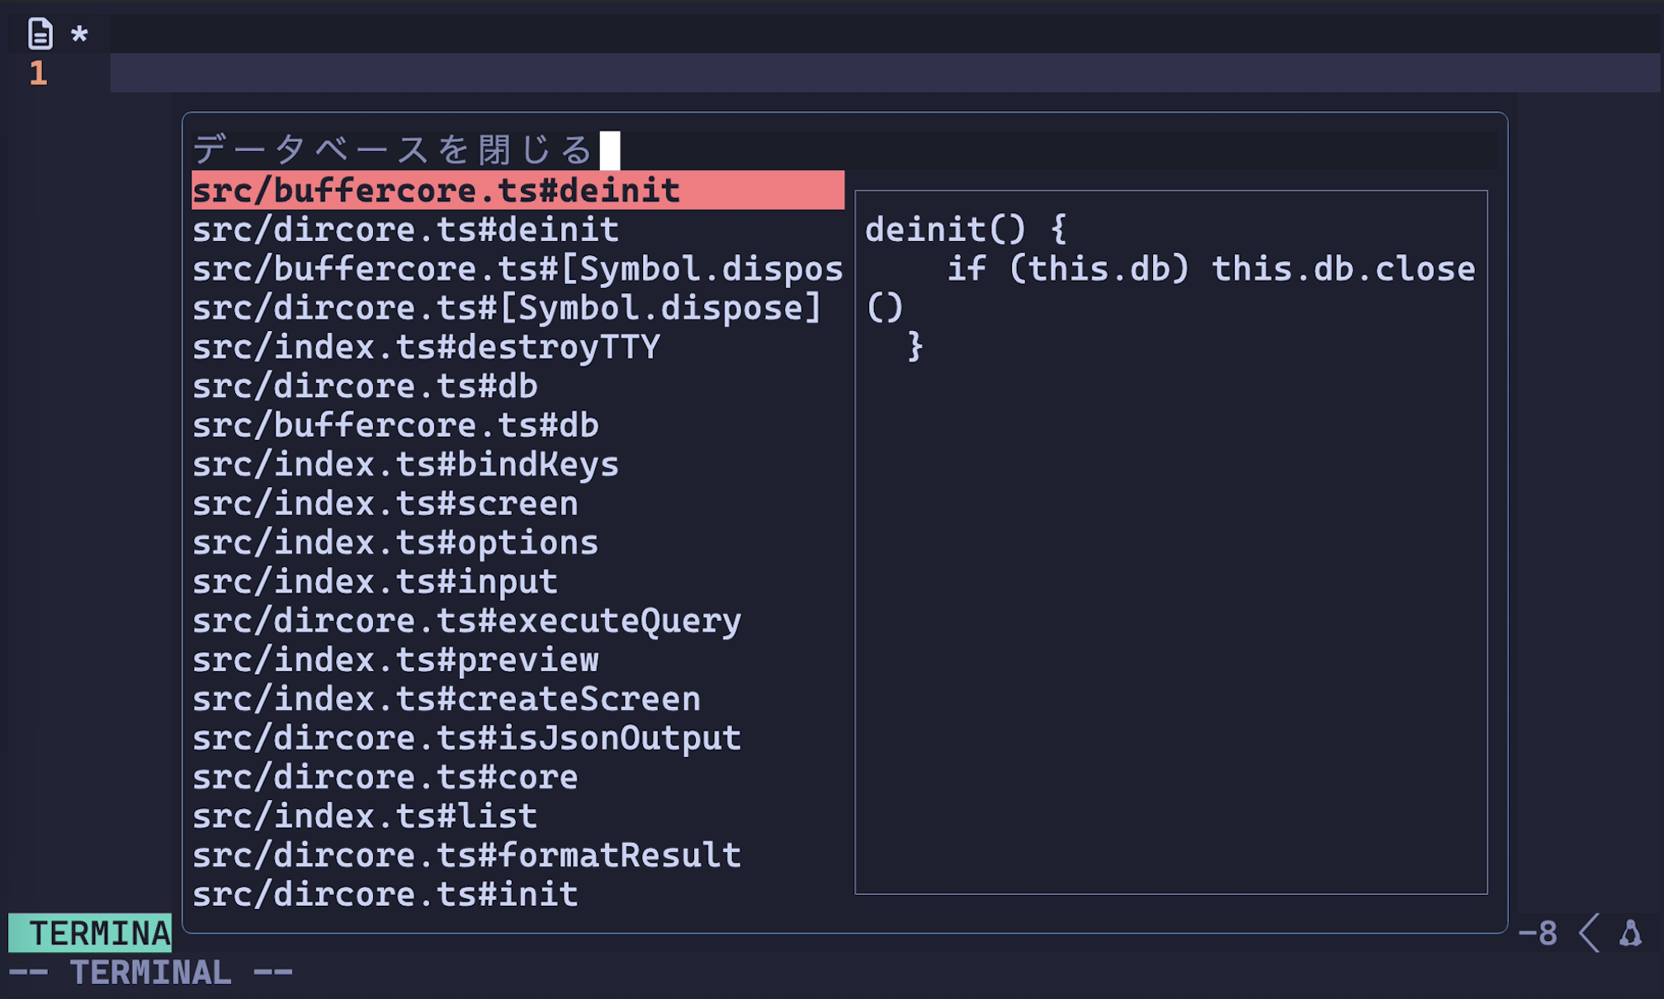
Example 1: FlfDir
flf-vim
Notes:
Let's look at an example. The `FlfDir` command recursively analyzes the code in a directory. When you enter "close the database" in Japanese, you can see that it actually displays the `deInit` function. It understands the words "database" and "close" and is able to select the appropriate function.

Slide 11
Problem
flf-vim
Notes:
However, "FlfDir" has a big problem.
When the amount of code becomes large,

Slide 12

Problem
flf-vim
”:FlfDir” takes a very long time
Example: Analyze vim source code
→ It takes
Notes:
indexing takes a very looooong time.
For example, when trying to analyze the Vim source code, indexing alone takes

Slide 13
Problem
flf-vim
”:FlfDir” takes a very long time
Example: Analyze vim source code
→ It takes over 1 hour
Notes:
over one hour.

Slide 14
Problem
flf-vim
”:FlfDir” takes a very long time
Example: Analyze vim source code
→ It takes over 1 hour
Not Fluent
Notes:
That is not "fluent," is it?

Slide 15

Example 2: FlfBuf
flf-vim
Notes:
Therefore, I developed another command, "FlfBuf". This command searches only the currently open buffers instead of searching the entire project directory.
In this GIF, it's indexing and searching buffers containing Vim's source code. It successfully finds the `strsize` function from the Japanese phrase "string size".
By limiting the search scope, indexing can now be done in a realistic amount of time.

Slide 16
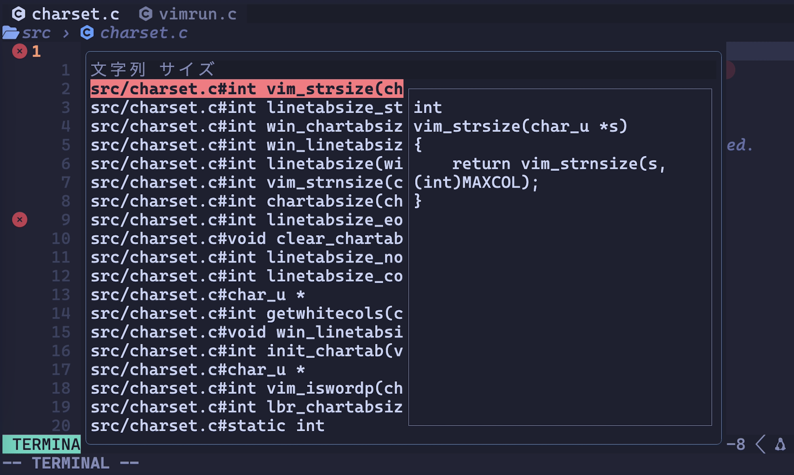
Example 2: FlfBuf
flf-vim
Notes:
Therefore, I developed another command, "FlfBuf". This command searches only the currently open buffers instead of searching the entire project directory.
In this GIF, it's indexing and searching buffers containing Vim's source code. It successfully finds the `strsize` function from the Japanese phrase "string size".
By limiting the search scope, indexing can now be done in a realistic amount of time.

Slide 17
Embedding Model
flf-vim
Use SLM(Small Language Model)
Safe
Cost-Effective
Fast
Notes:
Flf uses a local SLM, which stands for Small Language Model. Because it doesn't call an API, it's secure and cost-effective. Of course, it also runs quite fast, at least on my MacBook, due to the very small number of parameters.

Slide 18
Embedding Model
flf-vim
“ruri-v3-70m-code-v-0.1”
Finetuned “ruri-v3”
Notes:
The model used this time is `ruri-v3-70m-code-v-0.1`, which is a fine-tuned version of the `ruri` model developed at Nagoya University.

Slide 19


Embedding Model
flf-vim
“ruri-v3-70m-code-v-0.1”
Finetuned “ruri-v3”
Notes:
By the way, the person who fine-tuned this model...
isn't it possibly someone you've seen before?.

Slide 20
Conclusion
flf-vim
flf-vim allows searching with natural languages
Notes:
So, I introduced flf-vim, a finder plugin that allows searching with natural language.

Slide 21
More things to talk…
flf-vim
Unclear behavior in Vim’s `:buffer`
A bug I found during development that crashes Bun.js in just 4 lines
Hacks to support both Vim and Neovim
Notes:
There's still so much more I want to talk about:
"An enigmatic behavior in Vim's buffer commands,"
"A bug I found during development that crashes Bun.js in just 4 lines,”
"Hacks to support both Vim and Neovim“ ...
But unfortunately, 5 minutes is far too short to talk about all of these!
So, that's all for my presentation!

Slide 22
Thank you!
Notes:
Thank you!

Slide 23
How it works
Chunking Codebase
Convert to Embedding
Search

Slide 24

Chunking Codebase
Separates code into semantical chunks
E.g. Functions, Variables, Imports …
Powered by tree-sitter (via CodeChopper)

Slide 25

Get Embeddings
Calculate the vector that represents the meaning of each chunk (embedding)
Powered by ruri-code-70m-v0.1 (Execute on Local)
Safe
Cost-Effective
Fast (70M)

Slide 26

Search
Calculate the semantic distance from the query using cosine similarity
Use SQLite and sqlite-vec
Ranking with nearest neighbor search (HNSW)

Slide 27
So, what exactly is a Fluent Finder in the first place?
Sirasagi62

Slide 28
So, what exactly is a Fluent Finder in the first place?
Sirasagi62
Well, it’s something that finds things in a Fluent way.
tokinasin

Slide 29
Why not fantastic or fabulous but “Fluent"?
Sirasagi62
It’s because -
Anonymous T

